Slide 1
Developmental Disabilities Awareness Month 2024
Robin Troutman, Deputy Director, NACDD
Rafael Rolon-Muniz, Communications and Program Coordinator NACDD

Slide 2
Today’s Webinar:
About the campaign
How to get involved
What to do if you don’t use social media
Messaging Guide
Questions
Contact info

Slide 3

Developmental Disabilities Awareness Month:
March is DD Awareness Month
In 1987 President Ronald Reagan officially declared the month of March as National Developmental Disabilities Awareness month.
Our focus is to highlight diversity, inclusion and equity.
We work with our various audiences to reach out beyond our everyday networks

Slide 4
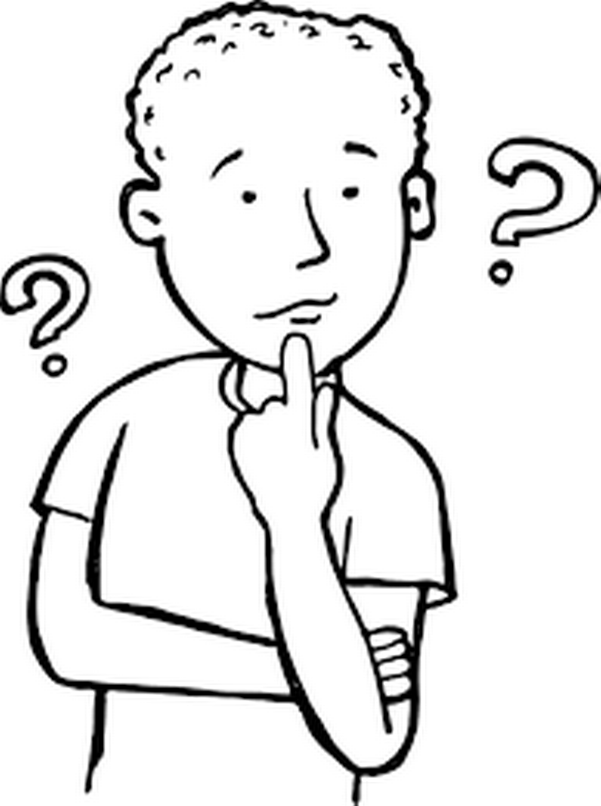
Before the Campaign:
Decide what you want to share and how you want to share it.
Spread the word!
Send your stories, photos, videos and resources to NACDD:
  YouTube
  LinkedIn
  Facebook
  Twitter (X)
  Instagra,

Slide 5

About the Campaign:
The goal of the campaign is to raise awareness by having people with and without disabilities sharing their stories about living alongside each other
Participants can share photos, videos and stories.
Resources will be shared on topics like education, employment, community living, accessibility, and inclusion.

Slide 6
Who can Participate?
EVERYONE!
  DD Councils (staff & councils)
  Your constituents
  People in your network and partners
  People outside of your network
  Other DD organizations
  Anyone who wants to!

Slide 7
This year's theme:
“A World of Opportunities” - we're celebrating people and working together to remove obstacles. Our goal is to build a community that's committed to creating a world where everyone can do well and succeed. Join us in making a world where all kinds of people have the chance to thrive.

Slide 8
DD Awareness Month 2024 Artwork
Lee Waters, Alaska, ‘What?’

Slide 9
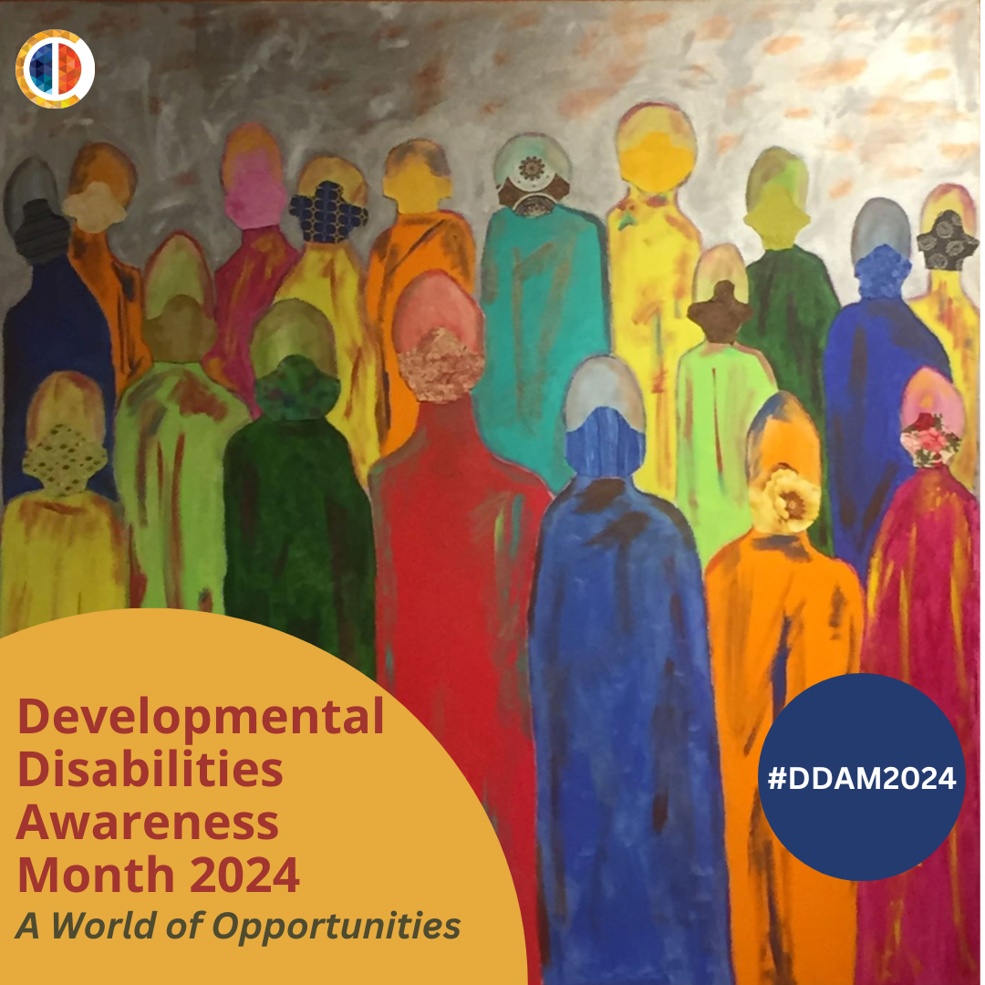
DD Awareness Month 2024 Posters

Slide 10
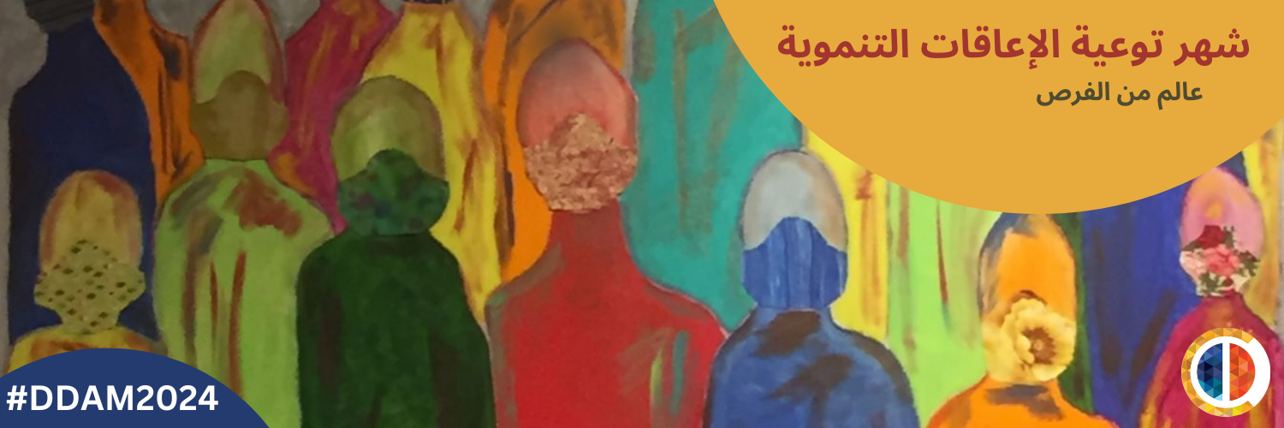
Posters and Cover photos
Posters and cover photos can be found in:
  English
  Spanish
  Italian
  French
  Arabic
  Cantonese
  Japanese

Slide 11
Social Media and messaging guide
For more social media how-to guides and best practices, visit the NACDD and ITACC websites and read our Social Media and Messaging Guide.

Slide 12
How Can I Take Part?
Facebook
  Tag the National Association of Councils on Developmental Disabilities
  Post photos, videos or stories about what is happening in your state
  Share posts from other people and pages
  Use the hashtag #DDawareness2024, #DDAM2024, or #NewOpportunities
Twitter (X)
  Tweet photos and stories
  Retweet @NACDD
  Use the hashtag #DDawareness2024, #DDAM2024, or #NewOpportunities
  Retweet and @ other groups in your state

Slide 13
How Can I Take Part?
LinkedIn
  Tag the National Association of Councils on Developmental Disabilities
  Post photos, videos or stories about what is happening in your state
  Use the hashtag #DDawareness2024, #DDAM2024, or #NewOpportunities
Instagram
  Share photos
  Tag @NACDD_56
  Use the hashtag #DDawareness2024, #DDAM2024, or #NewOpportunities

Slide 14
What if you don’t use Facebook/Twitter?
Email content to your DD Council or to NACDD
  Rtroutman@nacdd.org
  Rrolon-muniz@nacdd.org
Encourage others to post on their social media and use the hashtag #DDawareness2024, #DDAM2024, or #NewOpportunities.

Slide 15
Other Ways to Participate:
Send your resources to NACDD!
  We want to showcase the amazing work that you, your family, your Council, your state or your organization are doing!
  Email us your resources so we can share them with everyone else!
  Resources can include blog posts, studies, information about education, community living, families, health/healthcare, videos, pictures or anything else that you think can be a helpful resource to others!

Slide 16
Expand Your Network!
To truly make this a public awareness campaign, we must go beyond our current network.
Consider reaching out to:
  Businesses
  Legislators
  Schools
  Diverse Communities
  News Stations
  Other organizations
Enlist your DD council members or board members!

Slide 17
How We’ll Raise Awareness
By using the hashtags #DDawareness2024, #DDAM2024, or #NewOpportunities to link posts across all social media platforms
By sharing stories, photos and videos of people with and without disabilities living side by side on social media
By sharing resources about living inclusive lives

Slide 18
Questions?

Slide 19
Thank you!
If you have any questions after today, you can email Robin at rtroutman@nacdd.org or Rafael at rrolon-muniz@nacdd.org
Both can be reached at 202-506-5813

